Slide 1


APPLICATION CHEMISTRY
A2 LEVEL
MATERIALS AND DESIGN
CHAPTER 4:
ENVIRONMENTAL CHEMISTRY

Slide 2
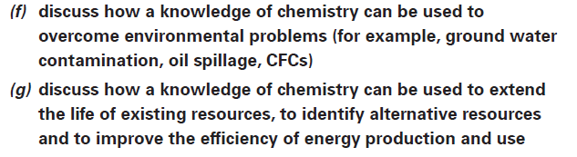
What you should know…

Slide 3
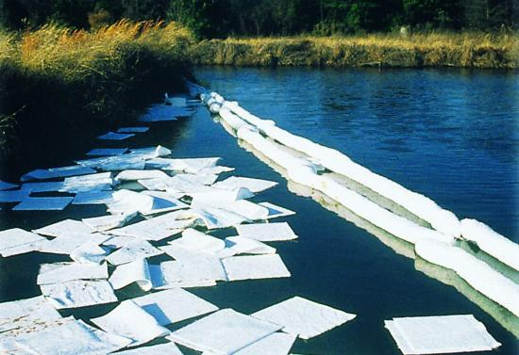
Oil slicks
Formation of oil slicks when oil is spilled from oil tankers whilst at sea.
Slicks are prevented from spreading and cleaned up as quickly as possible.
A new method for preventing slicks from spreading is to make booms that can be used to soak up oil spills.
Porous materials called sorbents exist that will soak up oil and water.
This makes them much less effective as they soon sink.

Slide 4
Oil slicks
To overcome this problem – increased the ability of these sorbents to absorb oil.
This major improvement has been achieved by making a porous fibreglass sorbent boom that repels water and allows oil to be absorbed.
The secret is to trap fluorinated molecules in the structure of the fibreglass sorbent.
The fluorine has hydrophobic properties and so repels water but allows oil in.

Slide 5
Oil slicks
To make: Dipped fibreglass into a slurry of silica and then into a chemical containing fluorine.
The resulting material is dried and then cut into discs.
When tested by shaking with a mixture of crude oil and salt water, the discs absorbed over 200 times their weight in oil, and they did not sink.

Slide 6
Remediation of contaminated soils
There are two main approaches to cleaning soil.
Relies on knowledge of the
physical properties
chemical properties of the pollutant

Slide 7
Soil remediation using physical properties
Pollutants can move through the soil by diffusion or convection.
Diffusion occurs where there are concentration differences in molecules, spreading out the contamination.
Convection occurs when molecules are driven by a fluid such as rain or wind.

Slide 8
Soil remediation using physical properties
Water picks up particles as it moves through the soil, carrying them further from the initial spill.
These mechanisms that spread the spillage can help the process of cleaning up the contaminated soil.
To wash out oil-based contaminants such as diesel fuels, a similar viscous fluid or foam can be pumped through the soil from a hole on one side of the region and pumped out of a hole on the other side, with the contaminants dissolved in the foam.

Slide 9
Soil remediation using physical properties
For gaseous (volatile) contaminant:
  can be flushed out of soil simply by pumping air through.
  can be made to vapourise by heating the soil with warm air and heating coils.
Inserting electrodes into soil, any charged or polar contaminants can be made to move towards one electrode.
When this method is used, the soil near the electrode is removed and treated further before being returned.

Slide 10
Soil remediation using physical properties
Some soil remediation will happen of its own accord as bacteria in the soil break down complex chemicals into CO₂.
Another way of breaking down the contaminants is to add chemicals to the soil.
Polyaromatic hydrocarbons (PAHs) are a major pollutant of contaminated soils.
They result from incomplete burning of carbon-containing materials and have structures based on benzene rings.
Ozone has been shown to break down PAHs and can be pumped into the ground to degrade the pollutants as it passes through the soil.

Slide 11
Remediation of contaminated ground water – plants to the rescue
Ground water is the water that is present below ground.
It may be present in the soil or it may be held in porous rock such as chalk.
Chalk is particularly good at filtering and purifying water supplies

Slide 12

Remediation of contaminated ground water – plants to the rescue
People in Bangladesh became ill from drinking this water and they were found to have arsenic in their bodies.
http://www.nbcnews.com/id/37958050/ns/health-health_care/t/arsenic-water-killing-bangladesh/

Slide 13

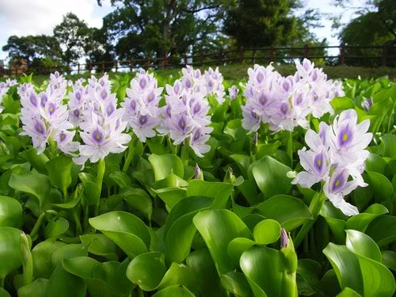
Remediation of contaminated ground water – plants to the rescue
The whole plant (water hyacinth) was able to remove arsenic from water and the recent research exploits the affinity of the plant for arsenic.
Believe that powdered root will be easier to use than the whole plant and is more effective than other methods of removal.
http://weloveourbangladesh.blogspot.com/2011/05/water-hyacinthkochuripana-beauty-and.html

Slide 14

Trouble in the stratosphere – replacing CFCs
In the stratosphere CFCs absorb ultraviolet light that causes a photo-dissociation of carbon-chlorine bonds as shown below for CF₂Cl₂.
These radicals catalyse the breakdown of ozone to oxygen.
As the carbon-chlorine bond is very reactive, it photodissociates in uv light, as shown above.

Slide 15
Trouble in the stratosphere – replacing CFCs
Alternative - hydrofluorocarbons, for example CH₂FCF₃. Alkanes may also be used.
The presence of the C-H bonds is important because this enables the compound to break down before it reaches the stratosphere.
CFCs have a second adverse effect on the environment – they contribute to global warming.
The new replacements for CFCs may be better in terms of the ozone layer but they are still greenhouse gases.

Slide 16
Green Chemistry and Sustainability
Develop products and processes that are sustainable i.e. they do not impact on the environment in terms of pollution or depletion of resources.
To help chemists work towards this aim, twelve principles of green chemistry have been drawn up.

Slide 17
Green Chemistry and Sustainability
The twelve principles of green chemistry
  Prevention of waste is cheaper than cleaning it up once it is formed.
  The synthesis of a new chemical product is designed to ensure that maximum use of materials takes place.
  New chemicals are produced with no significant toxicity to humans or to the natural environment.
  New chemicals are designed to achieve their use, whilst keeping toxicity low,
  Use of solvents should be avoided.
  Energy efficiency should be maximised, ideally reactions should be carried out at room temperature and pressure.

Slide 18
Green Chemistry and Sustainability
  Feedstocks should be sustainable.
  Chemists often need to use temporary modifications to a compound in a synthetic route to a target compound. Such modifications should be minimised.
  It is better for a reaction to use a catalyst than a reaction that is not catalysed.
  Chemical products should be designed to break down naturally.
  Analytical monitoring of reaction processes enables prevention of production of hazardous materials.
  12. Safer chemistry reduces the risk of accidents.

Slide 19
Use of supercritical CO₂ as a solvent
The following are examples where chemists have employed these principals to design a green process or technology.
A supercritical fluid is a gas that is compressed and heated so that it shows properties of a liquid and a gas at the same time.
Carbon dioxide becomes a supercritical fluid at a pressure 7290 kPa and a temperature of 31°C.
Other supercritical liquids include xenon and ethane.

Slide 20
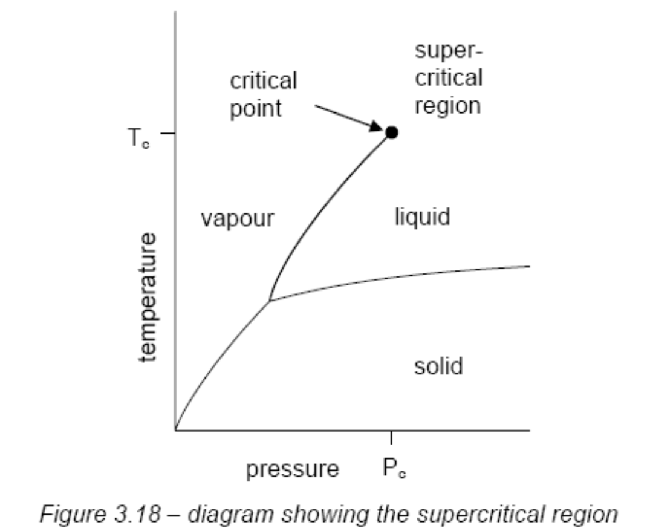
Use of supercritical CO₂ as a solvent

Slide 21
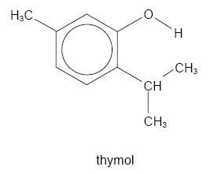
Use of supercritical CO₂ as a solvent
Thymol has the structure shown below.
It is a used as a perfume, disinfectant and also has medicinal properties.
Thymol is also used to make menthol.

Slide 22
Use of supercritical CO₂ as a solvent
A research found a process for synthesising thymol using supercritical CO₂ as a solvent and a more environmentally friendly catalyst, anhydrous aluminium oxide.
The use of supercritical CO₂ as a solvent avoids the need for organic solvents, many of which are volatile, flammable and may pose a risk to health and the environment.
What’s more, by controlling the temperature and pressure, its properties can be finetuned to minimise the production of by-products in the reaction and to increase the yield.
The process makes chemical reactions possible that were previously too polluting or inefficient.

Slide 23
Ionic Liquids
Ionic liquids are organic salts that have melting points below 100°C.
Use as solvents for chemical reactions as they can dissolve a wide variety of inorganic and organic compounds.
Ionic liquids, unlike organic solvents, have no vapour pressure and can be re-used.

Slide 24
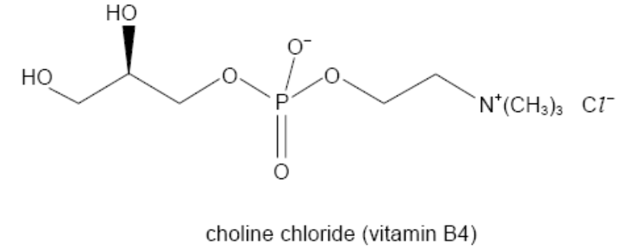
Ionic Liquids
Chromium plating is a highly hazardous process that makes use of chromic acid, a highly toxic and cancer forming compound.
A company called Scionix have produced an ionic liquid from chromium(III) chloride and choline chloride (vitamin B4).

Slide 25
Ionic Liquids
Another use of ionic liquids is in electropolishing of metals such as iron or aluminium, where ionic liquids have replaced sulphuric and phosphoric acids.

Slide 26
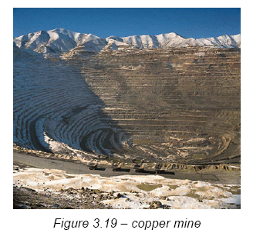
Rock-munching bacteria
Copper mining produces huge piles of waste that still contain copper.

Slide 27
Rock-munching bacteria
However, it is only recently that bacteria began to be used to extract this remaining copper.
The process is termed “bacterial leaching”.
The bacteria create an acidic solution, dissolving the copper from what was waste ore.
The copper is displaced by adding scrap iron, just as the Romans did! 10% of US copper now comes from bacterial leaching.

Slide 28
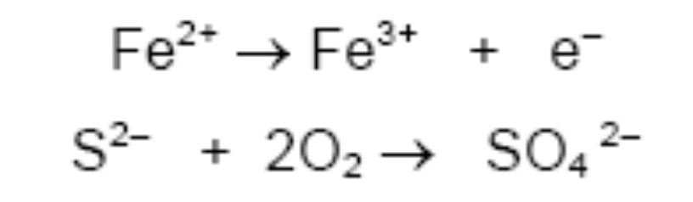
Rock-munching bacteria
As their names suggest (Thiobacillus ferro-oxidans and Thiobacillus thio-oxidans,), the bacteria actually use Fe²⁺ and S²⁻ ions in their metabolic processes, not the copper. They gain their energy to live from oxidation reactions such as the following.
The bacteria do not actually feed off the copper ore as the ions do not enter their cells.
Overall the bacteria produce a solution of iron(III) sulphate and copper(II) sulphate.

Slide 29
Rock-munching bacteria
The process of bacterial leaching is cheaper, more energy efficient, quieter and less polluting that other methods of extraction.

Slide 30
Rock-munching bacteria
Using bacterial leaching can raise the percentage of gold extracted to 85-100%.
However, Thiobacillus thio-oxidans prefers a temperature of about 30°C for optimum performance, much lower than the region where the gold mining takes place.
Thiobacillus thio-oxidans uses its unusual metabolism to turn pyrites (iron sulphide) and arsenopyrites ores into iron oxides. Any gold in the material can then be removed.

Slide 31
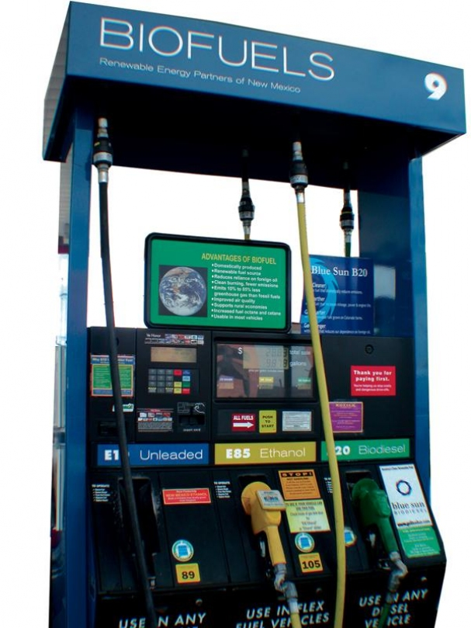
Chemistry for energy
Biofuels: diesel and ethanol fuels
Brazil and Columbia have powered their cars from ethanol made from sugar cane.
In South Africa, plants are being constructed to produce ethanol from maize, to be blended with petrol in proportions ranging from 10% to 85%.
In the US, the sugar in maize is also being used to produce ethanol.
In Europe, sugar beet is being used to produce ethanol and rapeseed oil is being used to provide a fuel suitable for diesel-powered engines.

Slide 32
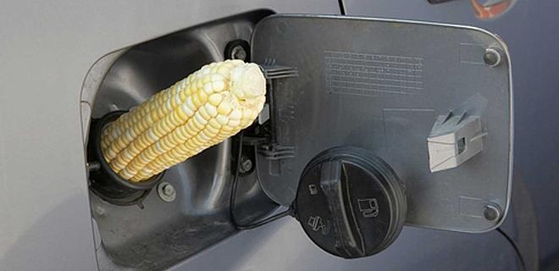
Biofuels: diesel and ethanol fuels
In US, Approximately 40 million tonnes of maize are being converted to bioethanol and the market is growing.
The fuel is being sold as E85, where 85% is ethanol, the remainder petrol.
However, the energy available from this fuel only just exceeds the energy used in the farming to produce the crop.
The process is not as efficient as it could be.

Slide 33
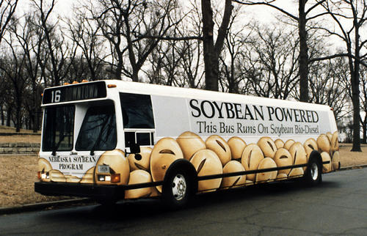
Biofuels: diesel and ethanol fuels
Other alternatives to oil-based fuels – Biodiesel.
Biodiesel refers to fuels that can be used in place of diesel and that are usually made from vegetable oils or animal fats.

Slide 34
Batteries and fuel cells
A typical fuel cell is a hydrogen cell and the reactants are hydrogen and oxygen.
The attraction of fuel cells is that, with the reactants being hydrogen and oxygen, the only product is water.
They are therefore emission-free.

Slide 35
Batteries and fuel cells
Both alkanes and hydrogen are used in fuel cells to propel vehicles.
A prototype Audi A2 has been built that runs on hydrogen, achieving 94 mpg, but with a limited range.
Norwegian road construction giant Mesta aims to cut their CO₂ emissions from their vehicles in half by use of hydrogen powered vehicles.
Hydrogen is stored in three 115 dm³ bottles at a pressure of 200 bar, giving the vehicle a 120 km range.

Slide 36
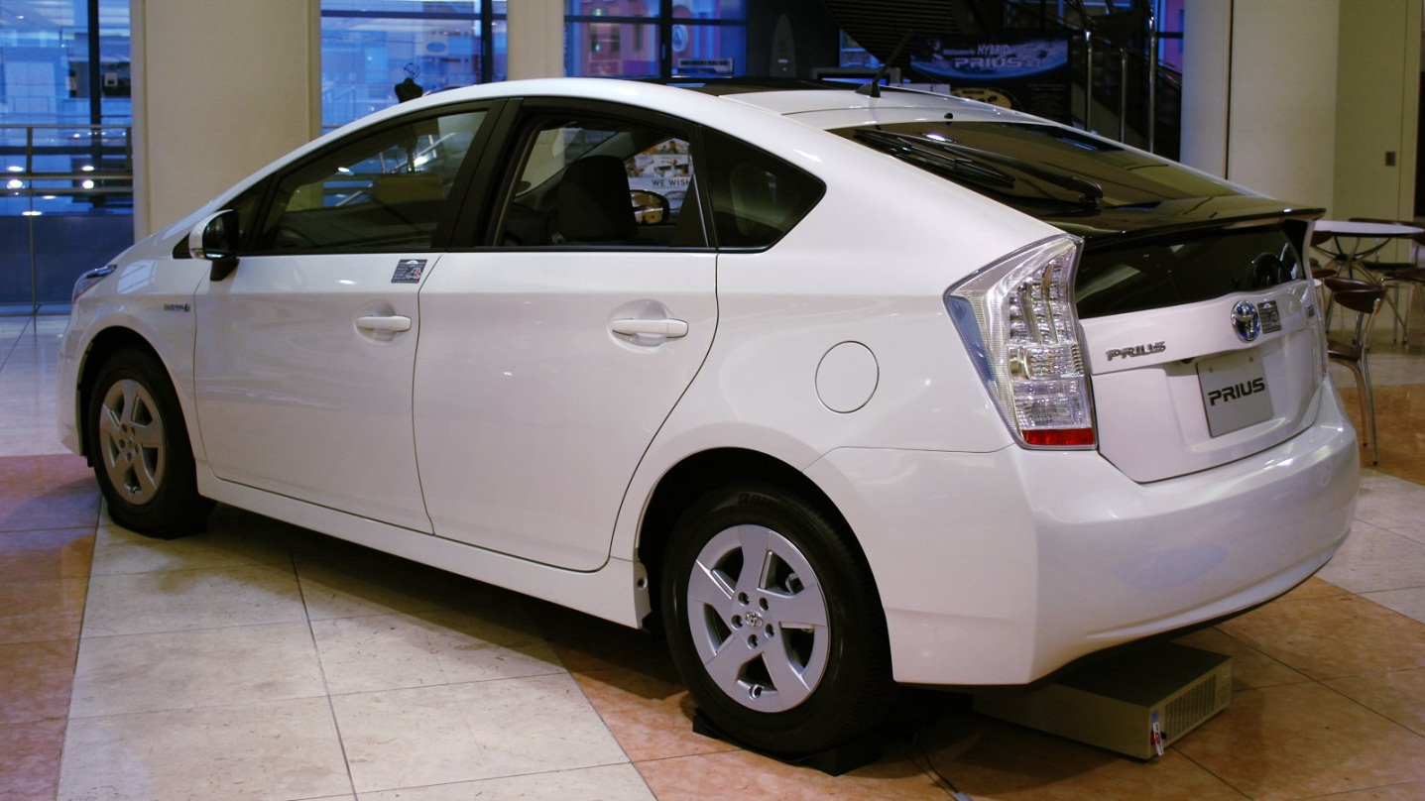
Batteries and fuel cells
Toyota Prius hybrid petrol/electric car has an electric motor that is driven by a bank of nickel metal hydride batteries that recharge when the car is coasting down hill and switches to petrol when acceleration is required.

Slide 37
Overcoming the hydrogen storage problem
Hydrogen gas must be compressed in order for it to be stored at a small enough volume on a vehicle.
This carries a significant risk of explosion.
An alternative approach is to find a solid material to absorb the hydrogen.
Sodium aluminium hydride NaAlH₄, a solid known to reversibly absorb hydrogen molecules.
High temperatures are needed and this hydride (and related hydrides) can only store about 5% by weight of hydrogen.

Slide 38
Overcoming the hydrogen storage problem
Doping this compound with titanium made the absorption and release of hydrogen much more efficient.
It appears that, unexpectedly, the titanium acts as a catalyst, forming a compound called titanium aluminide on the surface of the NaAlH₄.
Another method is to use porous materials which have many molecular sized holes that can absorb hydrogen and release it when needed.
Other researchers are investigating organic polymers that can form porous materials.

Slide 39
Sourcing hydrogen
Processes used to produce hydrogen are not necessarily environmentally friendly.
One option is electrolysis of water, but electricity is required for this process, and in most countries that electricity still comes primarily from power stations that burn fossil fuels.
The electrolysis of water usually requires 50% more energy that is stored in the hydrogen produced.
Another source of hydrogen is from methane in natural gas, but this process uses up natural resources and generates greenhouse gases.

Slide 40
The future of nuclear power, potentially the greenest of fuels?
Some of the key issues for use of nuclear power are as follows:
  Nuclear fuel can be viewed as a clean source of energy with zero emissions of greenhouse gases.
  Nuclear power stations generate radioactive waste products and we must be sure that these can be stored safely well beyond our lifetimes.
  (The work of chemists has much to contribute in terms of cleaning up nuclear waste.)
  Concern that an accident at or a terrorist attack on a nuclear plant
Some people believe that nuclear power is a cheap source of energy, others believe that the cost of cleaning up and securing nuclear waste is prohibitive.

Slide 41

END OF APPLICATION CHEMISTRY
END OF A2 SYLLABUS!

